Slide 1
Internet Architecture & Working

Slide 2
What is the Internet?
A network of networks, bringing together people, information, hardware and software around the World.
You can connect to the Internet:
dialing out to an Internet Service Provider (ISP) using SLIP (Serial Line Internet Protocol) or PPP (Point to Point Protocol).
directly through Cable Modem, DSL (Digital Subscriber Line), dedicated ISP connection, using TCP/IP (Transmission Control Protocol/ Internet Protocol).

Slide 3
What is the Internet?
The Internet is a network of networks of computers.

Slide 4
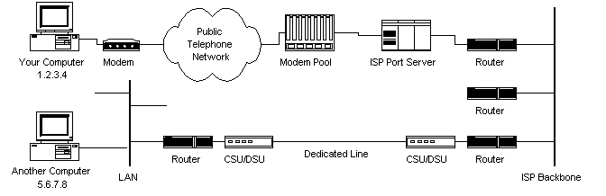
Internet Working

Slide 5
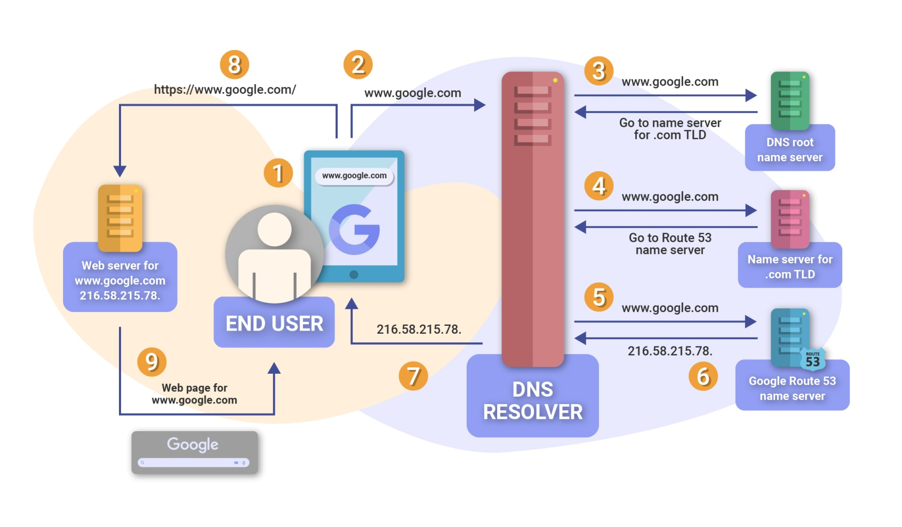
Internet Working

Slide 6
A Typical Internet Request
You type in a URL in your web browser (http://www.google.com)
The web browser needs to know the IP address that is assigned to this URL, so it makes a request to a Domain Name Server (DNS).
The request gets passed along from one name server to the next, until the address is found, or the request times out.

Slide 7
A Typical Internet Request
Once the browser has the IP address (123.456.789.123), it can prepare the HTTP request packets and send them to the server.
The message is divided into packets, which can be addressed with the source and destination IP addresses.

Slide 8
A Typical Internet Request
The message packets are then sent on their way.
From a dial-up connection, the first step is the ISP.
The ISPs router looks at the destination address, and if it can’t deliver the message, it passes it on to another router, etc. until the message reaches its destination.

Slide 9
A Typical Internet Request
The message reaches its destination site, usually a web server, which processes the request.
It then gets the requested page, if available, and prepares a reply message, including the requested information, and then divides it into packets and sends it back to the originator of the request.

Slide 10
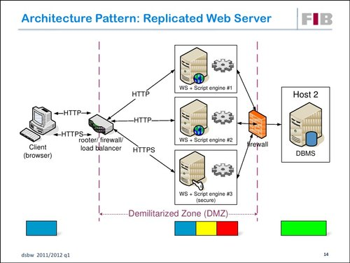
Architecture Web Server

Slide 11
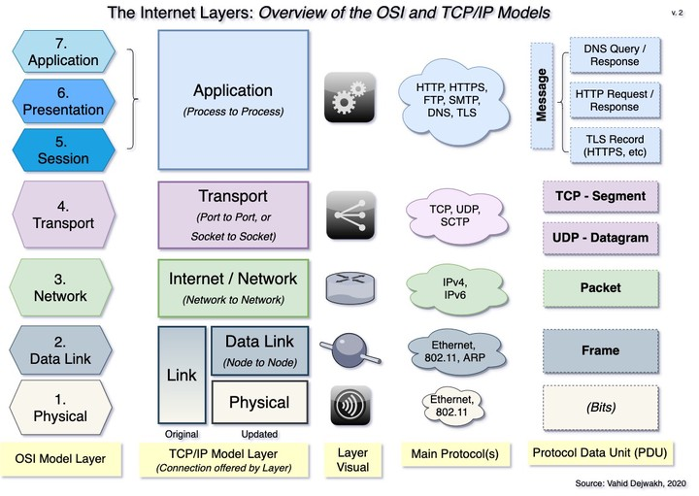
Internet Layers

Slide 12
What is the World Wide Web?
The World Wide Web is a hyperlinked network of documents and other resources found on the computers of the Internet.

Slide 13
How Domain work?
For example an Internet address (URL) like home.ublat.edu tell us that this address:
(a) belongs to the .edu -- education -- domain,
(b) is part of a network called ubalt (of course the name of the UB network), and
(c) that the machine (computer) name is home.
there are many different (top) domains like gov, mil, com, net, etc, with new ones being added presently.
each computer is assigned an IP number, like 198.202.0.35 -- the home.ubalt.edu IP number.
a computer with a Fully Qualified Domain Name (FQDN) has a fixed IP number and name registered in the Internet.

Slide 14
What can you do in the Internet?
Communications
Information search
File manipulation
Remote control of other computers
Cruise the Net through hypermedia
Electronic Commerce

Slide 15
Communications
Send/receive e-mail: the main use of the Internet.
Send/receive Chat room and Instant Messages: same time message exchange.
Participate in Web Forums: discussions, help and information.
Participate in Online Communities: Facebook, MySpace, YouTube.
Participate in Audio and/or Video Conferencing: same time voice and/or video communications.
Participate in mailing and discussion lists and newsgroups: you can get help and receive news.

Slide 16
Web browsers
A Web browser contains the basic software you need in order to find, retrieve, view, and send information over the Internet.
This includes software that lets you:
Send and receive electronic-mail (or e-mail) messages
worldwide nearly instantaneously.
Read messages from newsgroups (or forums) about
thousands of topics in which users share information
and opinions.
Browse the World Wide Web (or Web) where you can
find a rich variety of text, graphics, and interactive
information.

Slide 17
Information search
Web search engines like Google, Ask.com, etc.
Web site directories (portals) like Yahoo, MSN, etc.
former tools like Gopher, Veronica and WAIS are rarely used today.

Slide 18
Locating resources
In order for the WWW to be useful, we need a way of referencing all the resourses available.

Slide 19
URL Uniform Resource Locator
What does a URL do?
A URL allows every resource (e.g. HTML page, image, sound clip etc.) on the WWW to have a unique address.

Slide 20
Parts of a URL
The protocol gives the method of communication to be used. http is most common, but you may see ftp as well.

Slide 21
Parts of a URL
The domain name is the name of the computer that has the resource you want.
This computer is often called the host.

Slide 22
Domain names
Domain names are broken down into different levels.
E.g. www.someaddress.com
The top level domain name is com
The second level domain name is someaddress
The third level domain name is www

Slide 23
Parts of a URL
The exact path to the desired resource follows the domain name (and port number if given).

Slide 24
Request/Response
The HTTP protocol is set up to work in terms of requests and responses.
In a typical WWW example, you type in a URL in your browser’s location window, and press enter.
Your browser then sends a message (request) to a web server, asking for a given HTML page.
The web server sends back the page, or a reason it can’t comply (response).

Slide 25
Standards on the Internet/WWW
Standards related to the World Wide Web (e.g. HTML) are set by the World Wide Web Consortium (W3C)
URL – www.w3.org
Standards released by the W3C are not necessarily implemented completely or in the same way by different web browsers.

Slide 26
